Slide 1
APAALX001 usage instruction
Issue: 01
Copyright © DONGGUAN LUXSHARE Technologies Co., Ltd. 2021. All rights reserved.

Slide 2
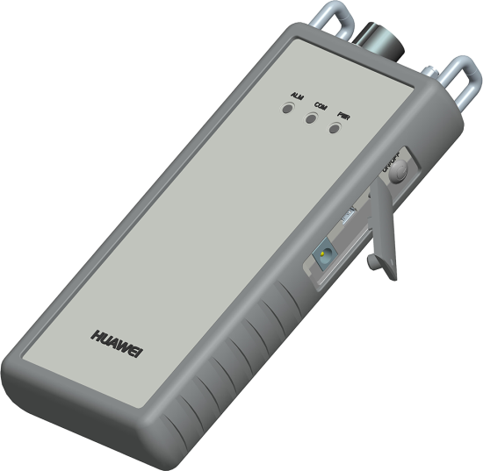
APAALX001 Appearance
AISG connection port
Power supply indicator
OOK connection port
Communication indicator
Strap hole
Alarm indicator
Power button
Mini USB port
12 V DC adapter port
Description | Function
AISG connection port | 1 x 8 core female connector, complying with the IEC 60130-9 standards Connects the PAT to an ALD using an AISG cable.
OOK connection port | Connects the PAT to an ALD using an RF cable.
Power indicator (PWR) | Indicates the power supply status.
Communication indicator (COM) | Indicates the status of communication between the PAT and smartphone.
Alarm indicator (ALM) | Indicates the PAT alarms status.
Power button | Used to power on or off the PAT. The PAT can be powered on or off by holding down this button.
Mini USB port | Reserved for further development and is not used temporarily.
12 V DC adapter port | Connects to the AC/DC adapter. When an AC/DC adapter is connected, the PAT automatically uses the input power supply as the operating power supply to charge the integrated battery.
2

Slide 3
Product Specifications of APAALX001
Specifications
Output voltage |  | 15 V DC 1 A (with a built-in rechargeable battery) 12 V DC 1 A (with an external AC/DC power adapter)
Overcurrent protection threshold |  | 1 A
Rechargeable battery |  | Lithium-ion battery (3.7 V, 10000 mAh)
Input voltage |  | 12 V AC/DC power adapter
Power adapter |  | Input: 100 V AC to 240 V AC, 0.55 A, 50 Hz to 60 Hz Output: 12 V DC, 2 A
Operating temperature (°C) |  | -20 to +55
Charge temperature (°C) |  | 0 to +40
PAT dimensions (H x W x D) (mm) |  | 30 x 204 x 88
Net weight (kg) |  | 0.52 (with a built-in rechargeable battery, and without a power adapter)
Maximum number of RCUs (PCS) |  | 6
Maximum length of the connection cable (m) |  | 100
Interface |  | Bluetooth 2.0 + EDR
Bluetooth | Frequency range | 2400 MHz to 2483.5 MHz (ISM-Band)
 | Receiving signal range | -82 dBm to -20 dBm (Typical)
 | Transmission power | Minimum: -18 … -16 dBm Maximum: +0 … +4 dBm (Class 2 device with 6 power control levels)
PAT:
Certificate: CE, MIC, VCCI, RoHS
Standards: EN/IEC 60950-1, EN 55032, EN 55024
Power adapter:
Model: APAALX001
Certificate: CE, MIC，VCCI,
Efficiency Level: Ⅵ
Efficiency Certificate： DOE, MEPS, NRcan
3

Slide 4
PAT Operation Process
Start
Install the PAT app.
§1.1 Scan the QR code and download the PAT app.
Connect the PAT to an ALD.
§1.2 Connect the PAT to an ALD.
Power on the PAT.
§1.3 Hold down the power button to power on the PAT.
Run the app.
Search for Bluetooth devices.
Connect a Bluetooth devices.
§1.4 Enter the app for selecting and connecting bluetooth devices.
Turn on the external power switch of the PAT.
§1.5 Turn on the external power switch of the PAT.
Scan ALDs.
Operate ALDs.
Exit the app and turn off the PAT.
End
4

Slide 5
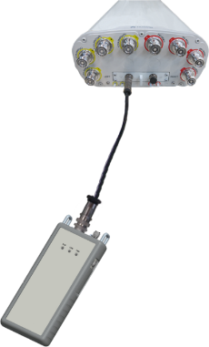
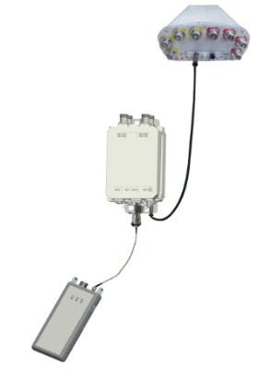
Procedure
§1.1 App Installation Guidelines
Method1：
Scan the QR code on the back of the PAT using the QR code scanning function of your smartphone, and then download the PAT app after the scanning is successful. (Some browsers may have use restrictions and the app cannot be downloaded. In this case, try a different browser.)
This app requires Android 4.0 or later. A smartphone with a 1.2 GHz dual-core CPU and 1 GB memory is recommended.
Method2：Open the mobile browser, enter http://www.luxshare-tech.com/4.3 ALD Files /file/PAT Build1.apk to download and install;
§1.2 Connecting the PAT to an ALD
RS485 mode
OOK mode
5

Slide 6
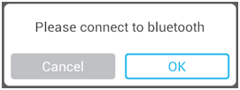
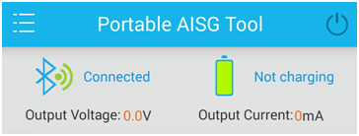
§1.3 Powering on the PAT
Hold down the power button. The PWR indicator is steady on, indicating that the PAT starts up properly.
When the PWR indicator is green, the battery percentage of the PAT ranges from 65% to 100%.
When the indicator is yellow, the battery percentage ranges from 20% to 65%.
When the indicator is red, the battery percentage is less than 20%.
If the PAT cannot be powered on or the PWR indicator is red, recharge the PAT using an appropriate AC/DC power adapter.
The PWR indicator blinks during recharging.
§1.4 Communication Between the Smartphone and PAT
Click Open. On the displayed Please connect to bluetooth dialog box, click OK to enter the GUI for selecting bluetooth devices, and click the bluetooth device name of the PAT to connect the PAT.
The bluetooth device name of the PAT consists of PAA and the last eight characters of the bar code labeled on the back of the PAT, and the bluetooth password is 1234.
After the connection is successful, the app notifies the user that the PAT has been connected, and the main PAT GUI is displayed. In this situation, the communication indicator on the PAT blinks.
If the connection fails, a notification indicating the failure is displayed at the lower part of the bluetooth GUI, and the bluetooth selection GUI of the app is still displayed.
External power supply switch on the PAT
Turn-on state
§1.5 Turning on the External Power Supply Switch of the PAT
As shown in the preceding figure, if the power button turns gray, the external power supply switch of the PAT has been turned off. If it turns white, the external power supply switch of the PAT has been turned off.
6

Slide 7
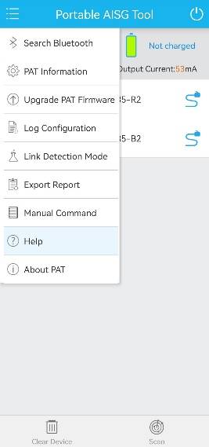
Obtaining Help Information from the App
The online help of the app describes PAT operations. The following figure shows how to obtain the online help.
Common Problems
There is no response during operation on the app:
Confirm whether the Bluetooth function of the smartphone is turned on.
Confirm whether Bluetooth devices have been paired.
Check whether the PAT is far away from the smartphone. In open areas, the measured maximum Bluethooth distance is about 30 m.
Check whether the communication indicator on the PAT is on; If multiple PATs are used, check whether the PAT is the right one displayed on the smartphone.
The PAT cannot be powered on.
Check whether the battery capacity is low. A fully charged PAT can be used to calibrate external RCUs for up to 80 times.
Recharge the PAT using an AC/DC adapter.
The PAT cannot be shut down when it is being used.
Hold down the power button to reset the PAT and then try to shut down the PAT again.
For details about other alarm information, see the online help of the app.
7

Slide 8
Routine Maintenance
During the use and maintenance of the PAT, its battery and shell must be protected.
Battery
The rechargeable battery inside the PAT is a lithium battery. Inappropriate use of the battery may compromise its life cycle or even lead to safety risks.
The battery cannot be overly recharged or discharged. Otherwise, its life cycle is compromised.
The PAT must be recharged and discharged at least once every one or two months if it is not used for a long time.
Please use the right AC/DC adapter.
If the PAT is used without any external power supply, ensure that the PAT is fully recharged.
The PAT must not be used or placed near high-temperature sources, such as fire or heaters. Otherwise, the battery may be overheated, disconnected, or even fail, thereby compromising the battery life.
The PAT cannot be used in places with strong electrostatic and magnetic fields. Otherwise, the battery safety protection unit may be damaged, causing safety issues.
If the battery becomes smelly, overheated, discolored, or deformed, or any other exception occurs during its use, storage, and recharging, stop using the PAT immediately.
The battery may fail if either of the following conditions are met:
The battery is fully recharged within two hours after the recharging starts.
An alarm indicating low battery power is displayed within one hour after the battery is used.
In this case, stop using the PAT immediately.
The rechargeable battery inside the PAT is provided by the battery supplier specified by Luxshare. If the battery needs to be replaced, contact Luxshare technical support.
Unused batteries must be properly disposed. The electrical polarity can be wrapped up using insulation material to prevent fire.
9

Slide 9
PAT Shell
The PAT shell is made of PC+ABS materials, and is vulnerable to scratches or breakage.
The battery must be kept away from violent collision when it is transported, carried, and stored.
If the PAT is to be used at a high position, it is recommended that the PAT be fastened using a strap or protected with a bag to minimize the possibility that the PAT falls to the ground.
After the PAT is used, the connection ports need to be protected using dedicated protective caps so that foreign matters cannot enter the PAT.
Silicone Shell
The protective shell of the PAT is made of silicone materials and is vulnerable to scratches or breakage.
The silicone shell cannot be in contact with keen-edge objects.
The silicone shell must not be frequently removed or violently stretched. Otherwise, the shell may be deformed.
It is recommended that the silicone shell be cleaned using wet cloth or a toothbrush with toothpaste or alcohol and then washed using clean water. Do not soak the silicone shell into water for a long time, violently brush the shell, or dry the shell at high temperature using a hair dryer.
The silicone shell may easily be covered with dust, grease stain, or other foreign matters due to electrostatic attraction. Therefore, it is recommended that the PAT be placed in a paper case at a cool and dry environment if it is not used for a long time.
Safety
Do not connect the PAT to an outdoor RET device in a thunderstorm.
Do not operate the device near the working antenna of a base station.
10

